Slide 1
Learning Objective
I will be able to reverse the process of differentiation to find the anti-derivative of simple polynomial functions
Success Criteria
At the end of the lesson, I will be able to:
reverse the process of differentiation to find the anti-derivative of simple polynomial functions
find the equation for an anti-derivative given initial conditions

Slide 2




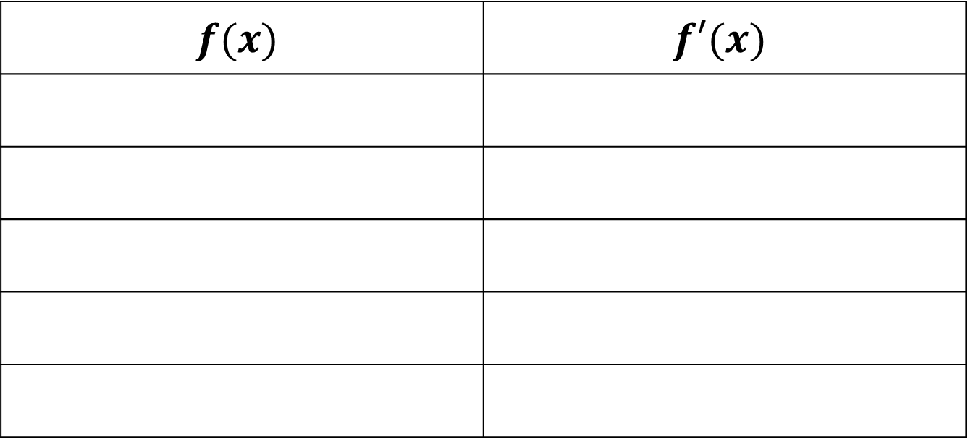






Rules of Anti-Derivative
Concept Development
$$f(x)$$ | $$f′(x)$$
$$x$$
$$1$$
$$x^{2}$$
$$2x$$
$$x^{3}$$
$$3x^{2}$$
$$x^{4}$$
$$4x^{3}$$
$$x^{5}$$
$$5x^{4}$$

Slide 3




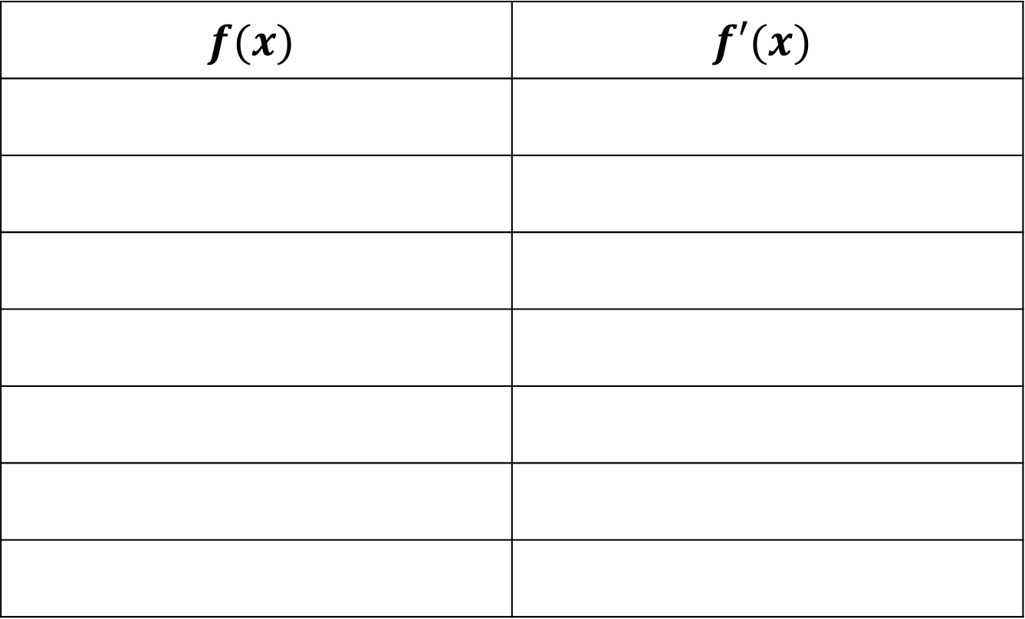









Rules of Anti Derivative
Concept Development
$$f(x)$$ | $$f′(x)$$
$$x$$
$$1$$
$${\frac{1}{2}x}^{2}$$
$$x$$
$${\frac{1}{3}x}^{3}$$
$$x^{2}$$
$${\frac{1}{4}x}^{4}$$
$$x^{3}$$
$${\frac{1}{5}x}^{5}$$
$$x^{4}$$
$$\frac{1}{n}x^{n}$$
$$x^{n−1}$$
$$\frac{a}{n}x^{n}$$
$${ax}^{n−1}$$

Slide 4
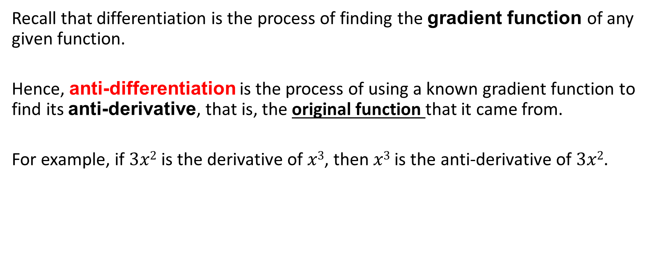
Anti- differentiation: Reversing the process of differentiation
Concept Development
Recall that differentiation is the process of finding the gradient function of any given function.
Hence, anti-differentiation is the process of using a known gradient function to find its anti-derivative, that is, the original function that it came from.
For example, if $3x2$ is the derivative of $x3$, then $x3$ is the anti-derivative of $3x2$.

Slide 5
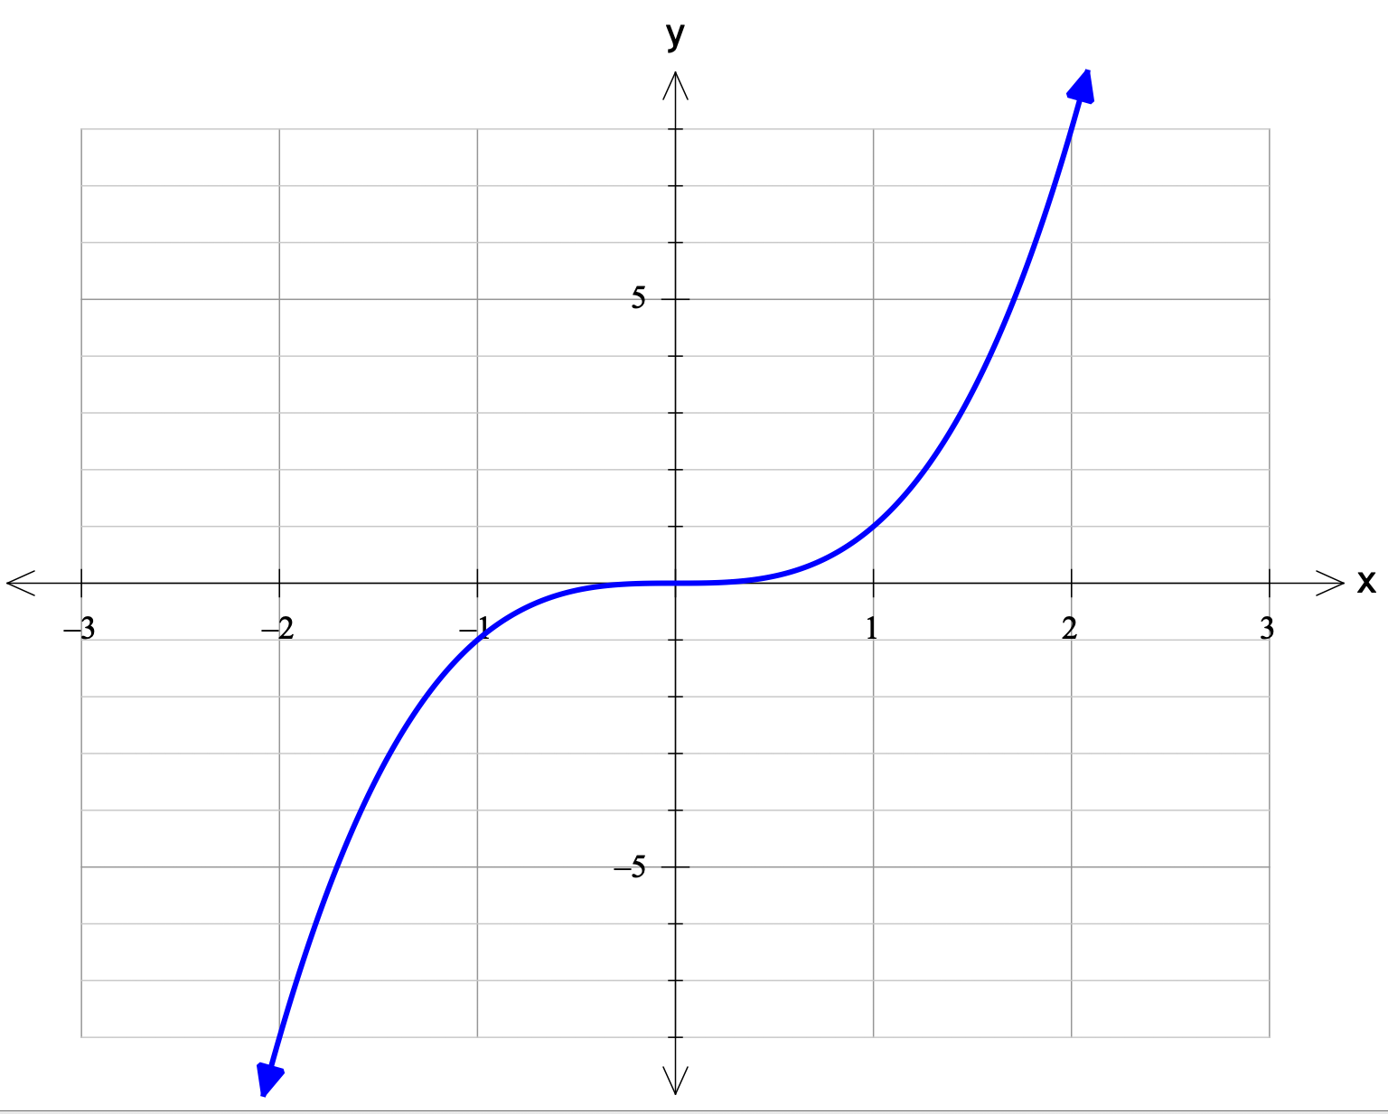

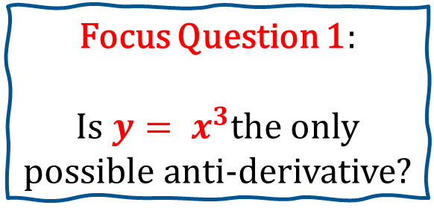
Power Rule Type Anti-Differentiation
Concept Development
If $\frac{dy}{dx}=3x^{2}$, then $y= x^{3}$
Focus Question 1:
Is $y= x^{3}$the only possible anti-derivative?

Slide 6
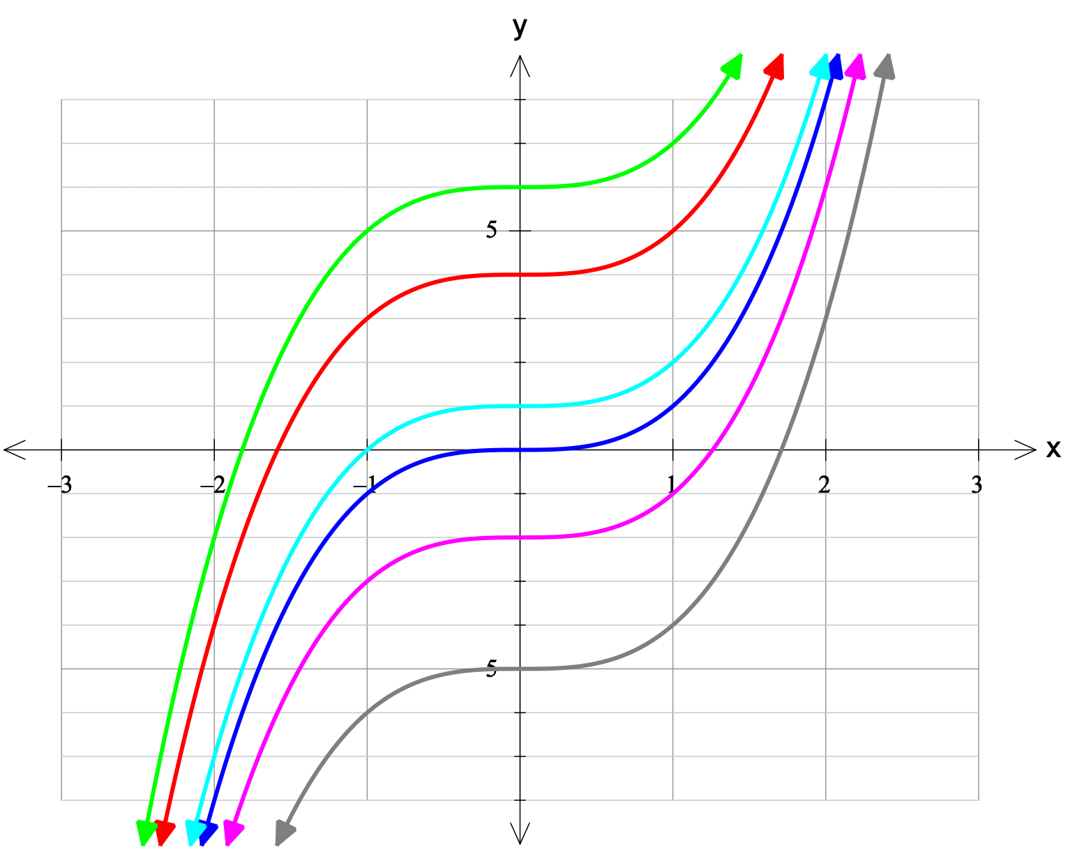
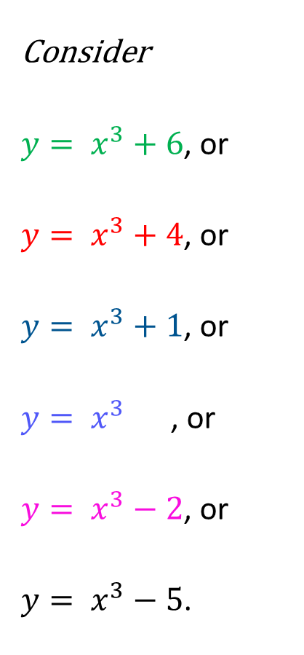




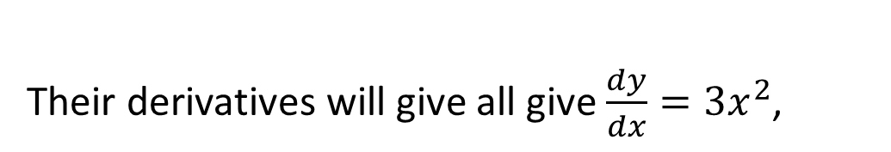


Concept Development
Consider
$y= x^{3}+6$, or
$y= x^{3}+4$, or
$y= x^{3}+1$, or
$y= x^{3}$ , or
$y= x^{3}−2$, or
$y= x^{3}−5$.
Their derivatives will give all give $\frac{dy}{dx}=3x^{2}$,

Slide 7
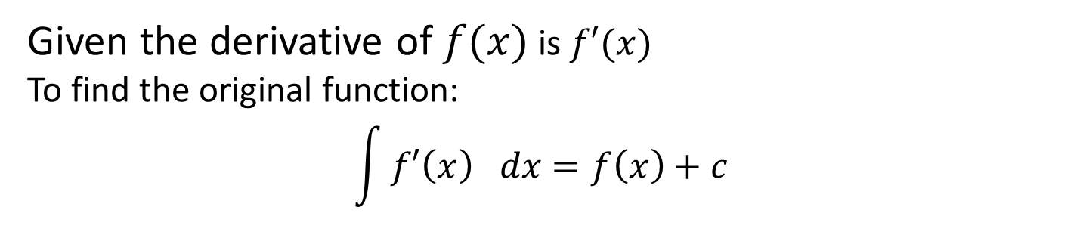
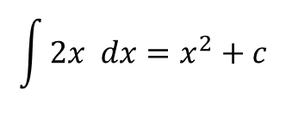
Rules of Anti-derivative
Concept Development
Given the derivative of $f(x)$ is $f′(x)$
To find the original function:
$$\int{f′\left(x\right) dx}=f\left(x\right)+c$$
This reads: “the integral of $f′(x)$ with respect to x is $f\left(x\right)+c$”
Example:
If $f^{′}\left(x\right)=2x$ , determine $f(x)$
$$\int{2x dx}=x^{2}+c$$

Slide 8
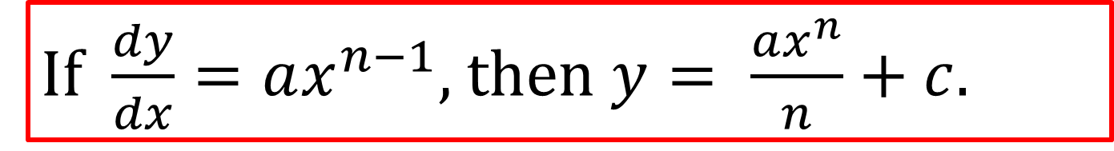
Power Rule Type Anti-Differentiation
Concept Development
Differentiation Generalisation | Anti-Differentiation Generalisation
Multiply by the power. Take 1 off the power. | Add 1 to the power. Divide by the new power.
If $\frac{dy}{dx}=ax^{n−1}$, then $y= \frac{ax^{n}}{n}+c$.

Slide 9







Anti-differentiate the following functions.
Guided Practice
a. $x^{6}$
b. $2v^{3}$
$$\int{x^{6}} dx$$
$$=\frac{x^{6+1}}{6+1}+c$$
$$=\frac{x^{7}}{7}+c$$
$$\int{2v^{3}} dv$$
$$=\frac{2v^{4}}{4}+c$$
$$=\frac{v^{4}}{2}+c$$

Slide 10

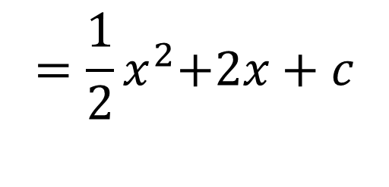

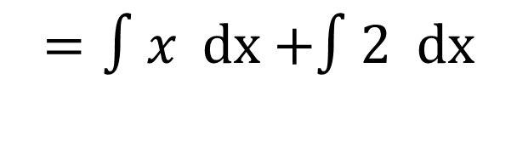


Sum rule
Concept Development
To find $∫f\left(x\right)+g\left(x\right) \text{dx}$
$$=∫f\left(x\right) \text{dx}+∫g\left(x\right) \text{dx}$$
Example:
$$f′(x)=x+2$$
$$f\left(x\right)=∫x+2 \text{dx}$$
$$=∫x \text{dx}\text{ +}∫2 \text{dx}$$
$$={\frac{1}{2}x}^{2}\text{+}2x+c$$

Slide 11

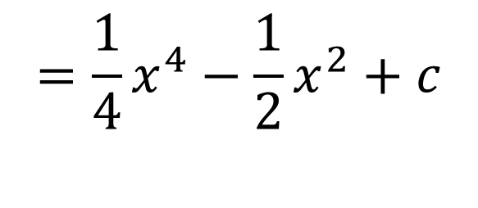

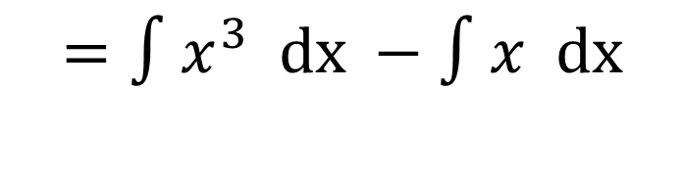


Difference rule
Concept Development
To find $∫f\left(x\right)−g\left(x\right) \text{dx}$
$$=∫f\left(x\right) \text{dx}−∫g\left(x\right) \text{dx}$$
Example:
$$f^{′}\left(x\right)=x^{3}−x$$
$$f\left(x\right)=∫x^{3}−x \text{dx}$$
$$=∫x^{3} \text{dx} −∫x \text{dx}$$
$$={\frac{1}{4}x}^{4}−\frac{1}{2}x^{2}+c$$

Slide 12
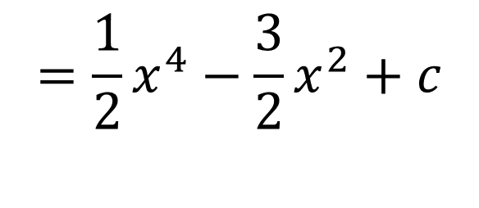

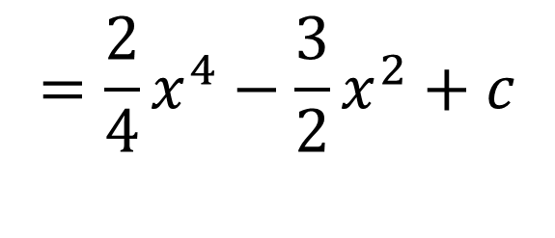

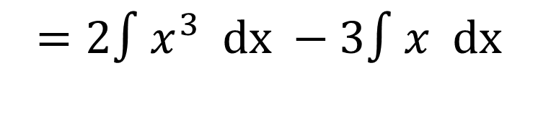


Integration rule by constant
Concept Development
To find $∫af\left(x\right) \text{dx}$
$$=a∫f\left(x\right) \text{dx}$$
Example:
$$f^{′}\left(x\right)=2x^{3}−3x$$
$$f\left(x\right)=∫2x^{3}−3x \text{dx}$$
$$=2∫x^{3} \text{dx} −3∫x \text{dx}$$
$$={\frac{2}{4}x}^{4}−\frac{3}{2}x^{2}+c$$
$$={\frac{1}{2}x}^{4}−\frac{3}{2}x^{2}+c$$

Slide 13
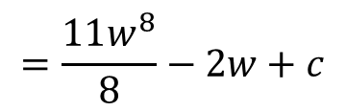






Guided Practice
Anti-differentiate the following functions.
b) ${11w}^{7}−2$
a) $t^{2}+6t$
$$\int{t^{2}+16t} dt$$
$$\int{11w^{7}−2} dw$$
$$=\frac{t^{3}}{3}+\frac{16t^{2}}{2}+c$$
$$=\frac{11w^{8}}{8}−2w+c$$
$$=\frac{t^{3}}{3}+8t^{2}+c$$

Slide 14







Guided Practice
$$∫x\left(x+\frac{1}{x}\right)dx$$
$$∫{\left(x−1\right)}^{2}dx$$
$$=∫x^{2}−2x+1 dx$$
$$=∫x^{2}+1 dx$$
$$=\frac{1}{3}x^{3}−\frac{2}{2}x^{2}+x+c$$
$$=\frac{1}{3}x^{3}+x+c$$
$$=\frac{1}{3}x^{3}−x^{2}+x+c$$

Slide 15
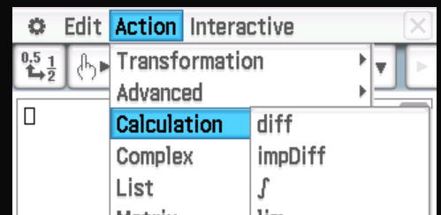
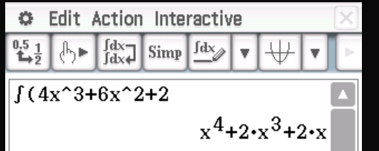
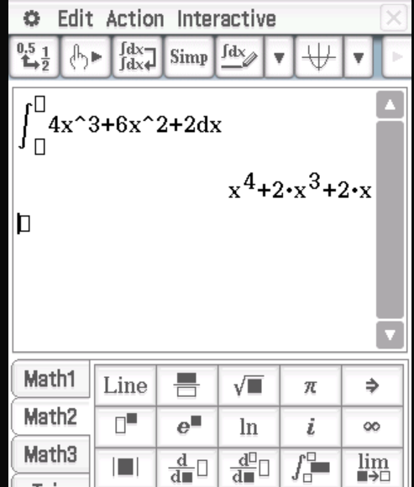

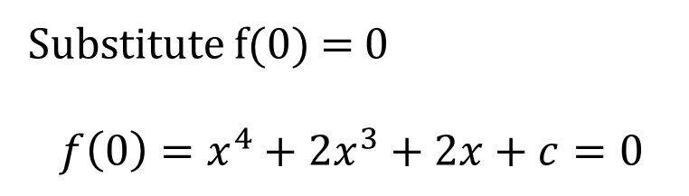




Guided Practice
Step 1: find the anti derivative, f(x)
$$f(x)=∫4x^{3}+6x^{2}+2 dx$$
$$=\frac{4x^{4}}{4}+\frac{6x^{3}}{3}+2x+c$$
$$f\left(x\right)=x^{4}+2x^{3}+2x+c$$
Substitute f(0) = 0
$$f\left(0\right)=x^{4}+2x^{3}+2x+c=0$$
$$c=0$$
$$f\left(x\right)=x^{4}+2x^{3}+2x$$

Slide 16
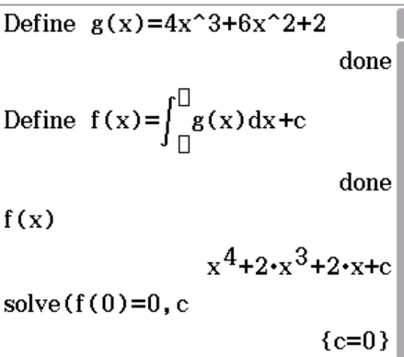
Guided Practice
Step 1: find the anti derivative, f(x)
Set up in ClassPad eActivity, new line: Anti-Derivative
$$f(x)=∫4x^{3}+6x^{2}+2 dx$$
$$=\frac{4x^{4}}{4}+\frac{6x^{3}}{3}+2x+c$$
$$f\left(x\right)=x^{4}+2x^{3}+2x+c$$
Substitute f(0) = 0
$$f\left(0\right)=x^{4}+2x^{3}+2x+c=0$$
$$c=0$$
$$f\left(x\right)=x^{4}+2x^{3}+2x$$

Slide 17



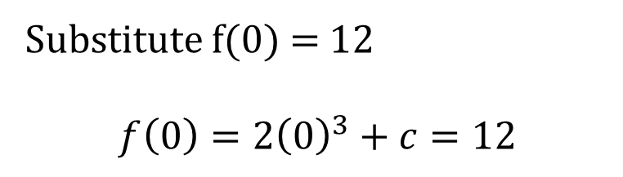


Guided Practice
Given that $f^{′}\left(x\right)=6x^{2}$
Step 1: find the anti derivative, f(x)
$$f(x)=∫6x^{2} dx$$
$$=\frac{6x^{3}}{3}+c$$
$$f\left(x\right)=2x^{3}+c$$
Substitute f(0) = 12
$$f\left(0\right)=2{\left(0\right)}^{3}+c=12$$
$$c=12$$
$$f\left(x\right)=2x^{3}+12$$

Slide 18
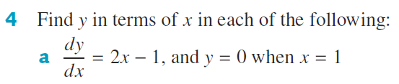


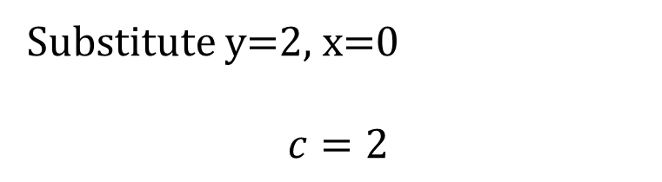




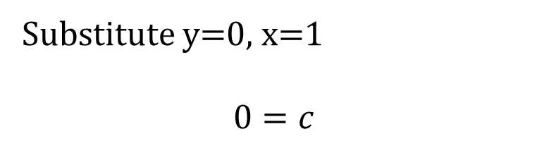



Guided Practice
$$y=∫2x−1 dx$$
$$y=\frac{2x^{2}}{2}−x+c$$
$$y=∫x^{2}+2x dx$$
$$y=\frac{x^{3}}{3}+\frac{2x^{2}}{2}+c$$
$$y=x^{2}−x+c$$
$$y={\frac{1}{3}x}^{3}+x^{2}+c$$
Substitute y=0, x=1
$$0=c$$
Substitute y=2, x=0
$$c=2$$
$$y=x^{2}−x$$
$$y={\frac{1}{3}x}^{3}+x^{2}+2$$

Slide 19



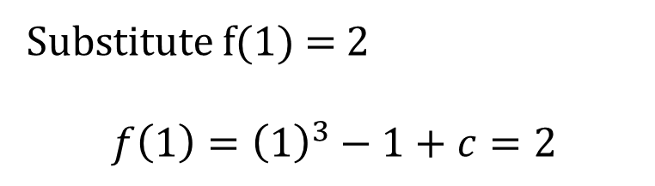


Guided Practice
Given that $f^{′}\left(x\right)=3x^{2}−1$
Step 1: find the anti derivative, f(x)
$$f\left(x\right)=∫3x^{2}−1 dx$$
$$=\frac{3x^{3}}{3}−x+c$$
$$f\left(x\right)=x^{3}−x+c$$
Substitute f(1) = 2
$$f\left(1\right)={\left(1\right)}^{3}−1+c=2$$
$$c=2$$
$$f\left(x\right)=x^{3}−x+2$$

Slide 20
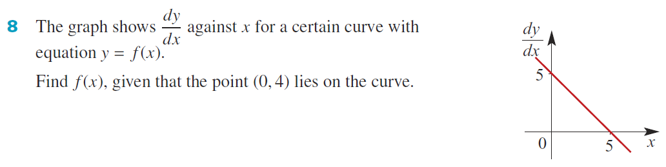




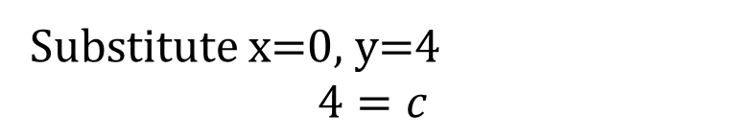



Guided Practice
F$ind the f^{′}\left(x\right)$ equation from the graph
What type of graph is it?
$$Linear, =mx+c$$
$$m=−1$$
Substitute x=0, y=4
$$4=c$$
$$c=5$$
$$\frac{dy}{dx}=−x+5$$
$$y=−\frac{1}{2}x^{2}+5x+4$$
$$y=\int{−x+5} dx$$
$$y=−\frac{1}{2}x^{2}+5x+c$$

Slide 21
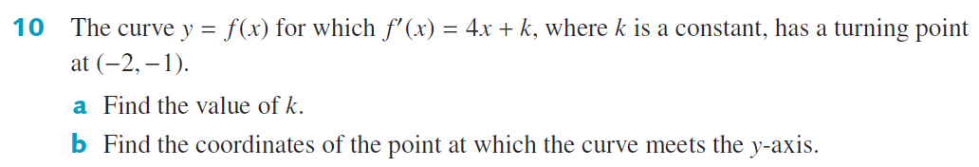











Guided Practice
At turning point, $f^{′}\left(x\right)=0$
$$f^{′}\left(−2\right)=4(−2)+k=0$$
Substitute x=-2, y=-1
$$2{\left(−2\right)}^{2}+8\left(−2\right)+c=−1$$
$$k=8$$
$$f′(x)=4x+8$$
$$8−16+c=−1$$
$$f(x)=\int{4x+8} dx$$
$$c=7$$
$$f(x)=2x^{2}+8x+7$$
$$f(x)=\frac{4}{2}x^{2}+8x+c$$
$$(0, 7)$$
$$f(x)=2x^{2}+8x+c$$

Slide 22










Guided Practice
Substitute, $\frac{dy}{dx}=3 , x=1$ to find $a$
$$a{\left(1\right)}^{2}+1=3$$
Substitute x=1, y=3
$$\frac{2}{3}{\left(1\right)}^{3}+1+c=3$$
$$a=2$$
$$\frac{dy}{dx}=2x^{2}+1$$
$$c=\frac{4}{3}$$
$$y=\int{2x^{2}+1 } dx$$
$$y=\frac{2}{3}x^{3}+x+\frac{4}{3}$$
$$y=\frac{2}{3}x^{3}+x+c$$
$$y=\frac{2}{3}{(2)}^{3}+2+\frac{4}{3}=8\frac{2}{3}$$

Slide 23












Guided Practice
F$ind$the gradient of the tangent
$$m=\frac{6}{3}=2$$
Substitute $\frac{dy}{dx}=2 and x=3$ to find k
Substitute x=3, y=6
$$6=9−4\left(3\right)+c$$
$$2=2\left(3\right)+k$$
$$k=−4$$
$$c=9$$
$$\frac{dy}{dx}=2x−4$$
$$y=x^{2}−4x+9$$
$$y=\int{2x−4} dx$$
$$y=x^{2}−4x+c$$

Slide 24







Guided Practice
$$\frac{dy}{dx}=x^{2}$$
$$y=\int{x^{2}} dx$$
$$y=\frac{1}{3}x^{3}+c$$
Substitute x=2, y=1
$$1=\frac{1}{3}{\left(2\right)}^{3}+c$$
$$c=1−\frac{8}{3}=−\frac{5}{3}$$
$$y=\frac{1}{3}x^{3}−\frac{5}{3}$$

Slide 25
Independent Practice
Complete Cambridge Ex 17G

